Slide 1

Bannerton Clients
Dublin & Dubai
June 2025

Slide 2







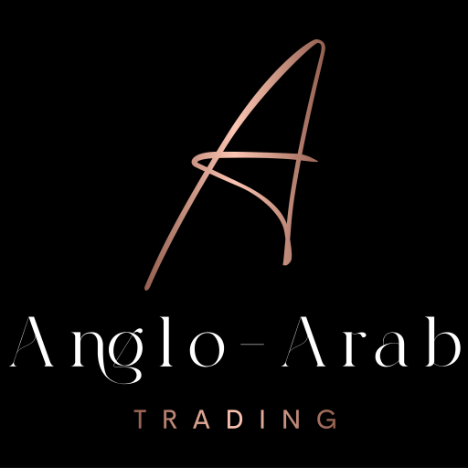


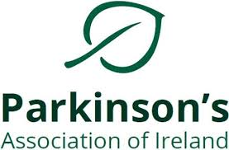




Healthcare / Biotech

Slide 3

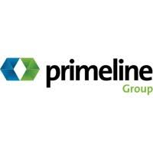




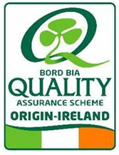

Food Sector

Slide 4










Property / Commercial / Professional Services

Slide 5







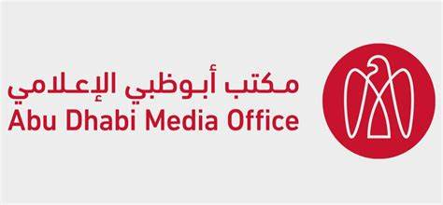
Corporate / Financial

Slide 6






Digital Tech/ Telecoms

Slide 7




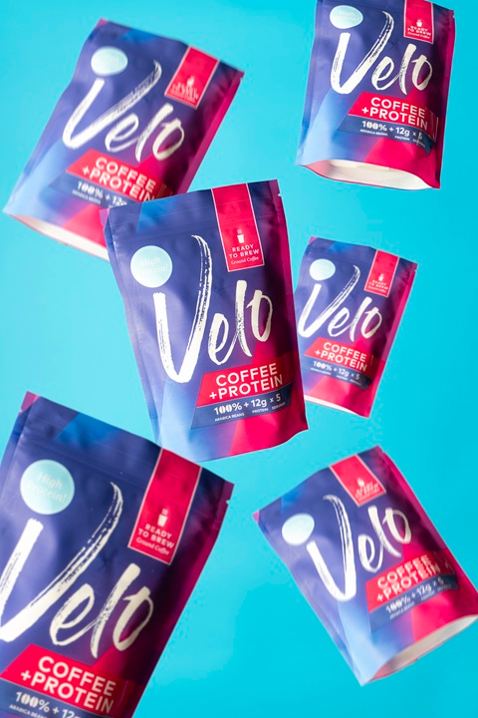



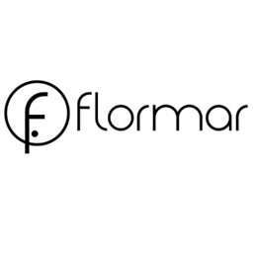


FMCG / Beauty / Retail

Slide 8

About Bannerton Dublin’s leading boutique PR agency
Founded in 2010 by Sharon Bannerton, a seasoned PR and marketing professional with over twenty years experience, and qualified Chartered Director (Inst of Directors)
A multi award-winning PR team of two account directors, a dedicated copywriter, and administrator, that is driven, results-focused, and delivers original, impactful communications that meet media, stakeholder and client requirements.
Significant experience in the healthcare services, advocacy, branded product and retail
Manage consumer, financial, public information and corporate campaigns, tailored to the client market, audience, budget and communications brief
We ‘make the news’, build brands and reputation, and reach the right audience, cost-efficiently and effectively, with the right message!

